Slide 1
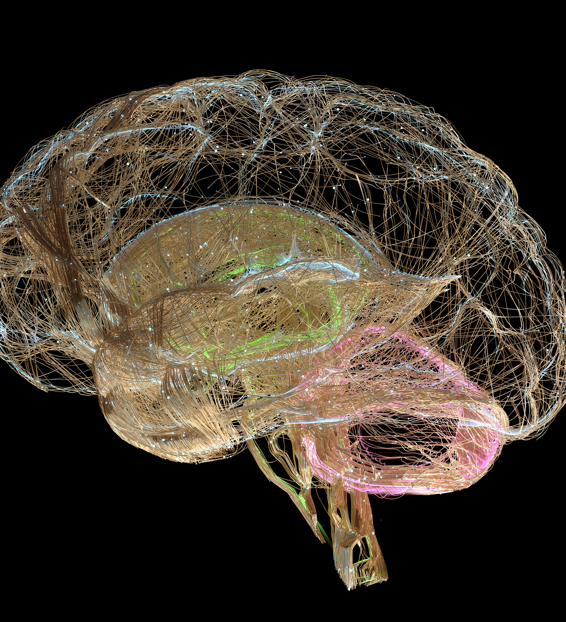
Identifying Alzheimer's Risk Factors and Prediction

Slide 2
Agenda
Key Recommendations
Data Exploration
Variable Selection
Models
Results
Summary

Slide 3
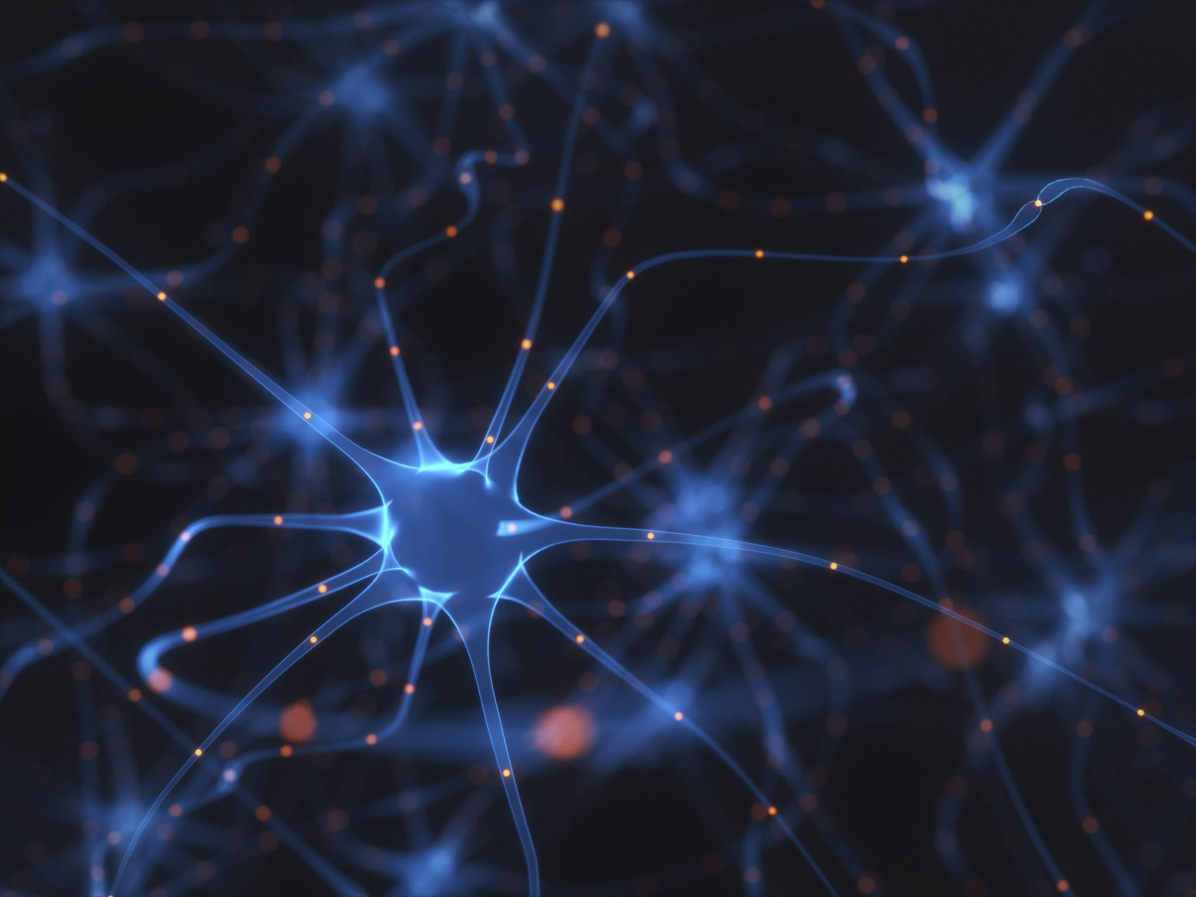
Key Recommendations
Adopt the Bayesian Network GLM Model
Use 3 Key factors to Determine Risk

Slide 4
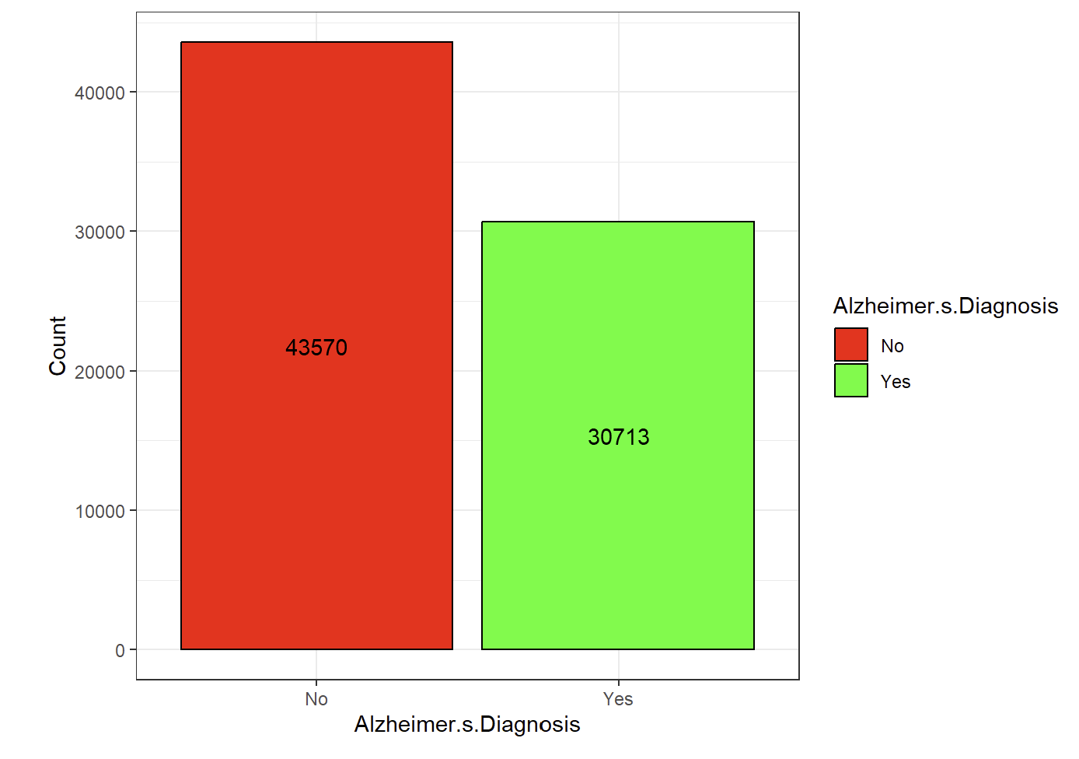
Data Exploration
Categorization: Countries grouped by continent to simplify the model.
Class Balance: Verified equal representation of Alzheimer’s and non-Alzheimer’s cases.
Significantly more patients without Alzheimer's.
Class Imbalance Adjustment: Applied weights (Alzheimer’s = 1.4, Non-Alzheimer’s = 1.0).
Data Transformation: Converted categorical predictors to numerical values.
Standardization: Centered and scaled predictor variables
Target variable remains unchanged.

Slide 5
Variable Selection
A model using no variable selection (all predictors) serves as a baseline to compare the performance of all other, reduced models.
Three categories of variable selection were used in this project:
No Variable Selection
Forward-Backwards Stepwise Variable Selection
Bayesian Network Variable Selection

Slide 6
Stepwise Selection: Forward-Backward
Stepwise selection (forward-backward) based on AIC.
Iteratively adds/removes variables to find the most relevant predictors.
Reduced variables from 24 to 5:
Age
Cholesterol Level
Family History of Alzheimer’s
Genetic Risk Factor (APOE ε4 allele)
Stress Levels
Urban vs Rural Living

Slide 7
Stepwise Selection: Forward-Backward
Stepwise selection (forward-backward) based on AIC.
Iteratively adds/removes variables to find the most relevant predictors.
Reduced variables from 24 to 5:
Age
Cholesterol Level
Family History of Alzheimer’s
Genetic Risk Factor (APOE ε4 allele)
Stress Levels
Urban vs Rural Living

Slide 8
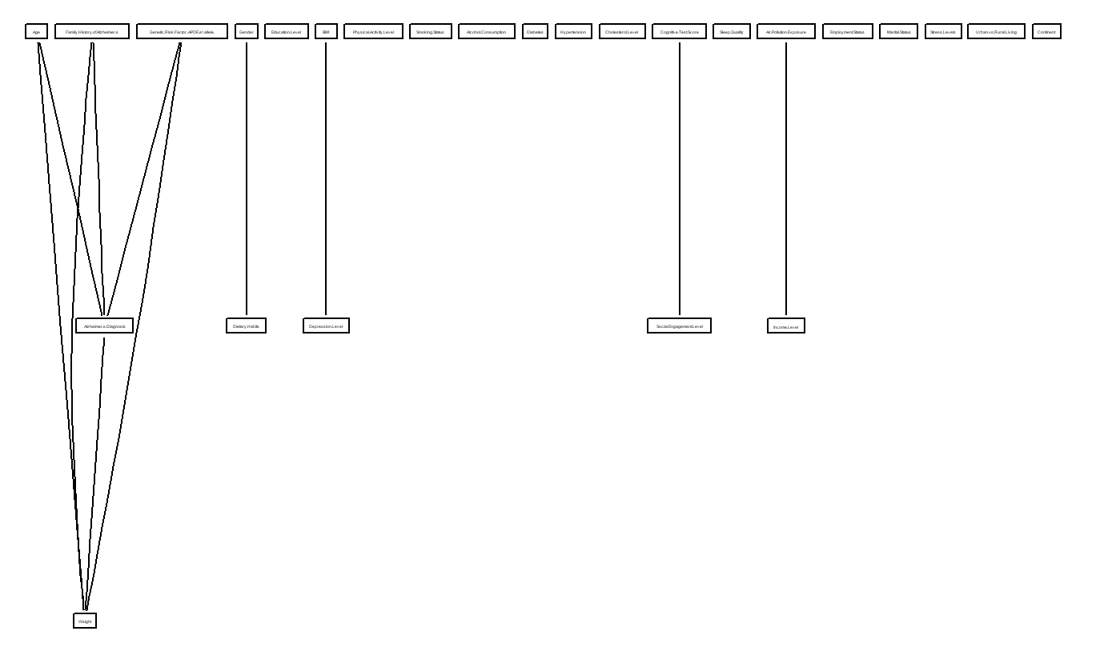
Bayesian Network: Constraint-Based
Bayesian Networks:
Use conditional probabilities to model relationships.
Graphically represents variable connections.
First tested model: HPC (constraint-based structure).
Produced an undirected graph
Not suitable for variable selection

Slide 9
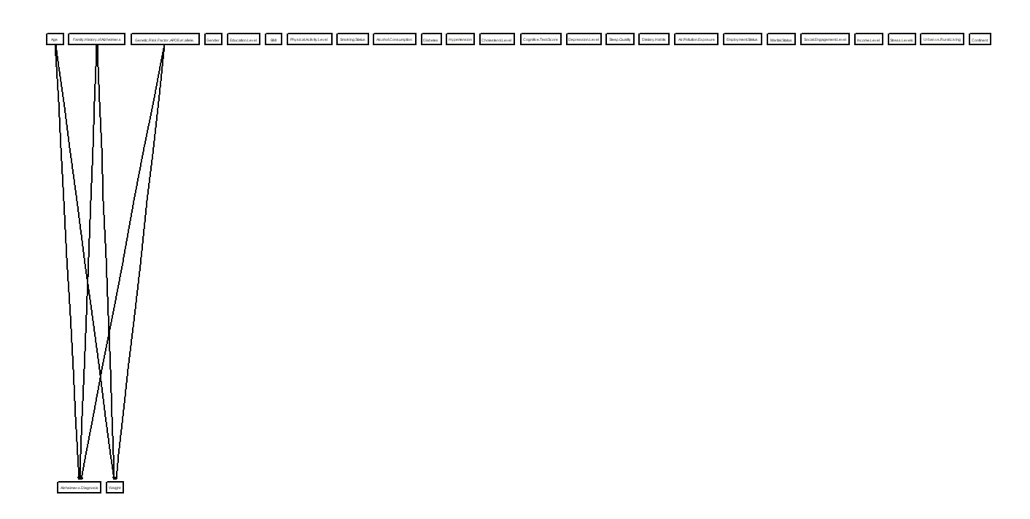
Bayesian Network: Score-Based
Second tested model: H2PC (score-based structure).
Produced a directed graph
Connected the variables:
Age
Family History of Alzheimer’s
Genetic Risk Factor (APOE ε4 allele).

Slide 10
Bayesian Network: Hybrid
The HC model utilizes a hybrid-based algorithm for predictor connections.
Results were identical to the score-based algorithm model.

Slide 11
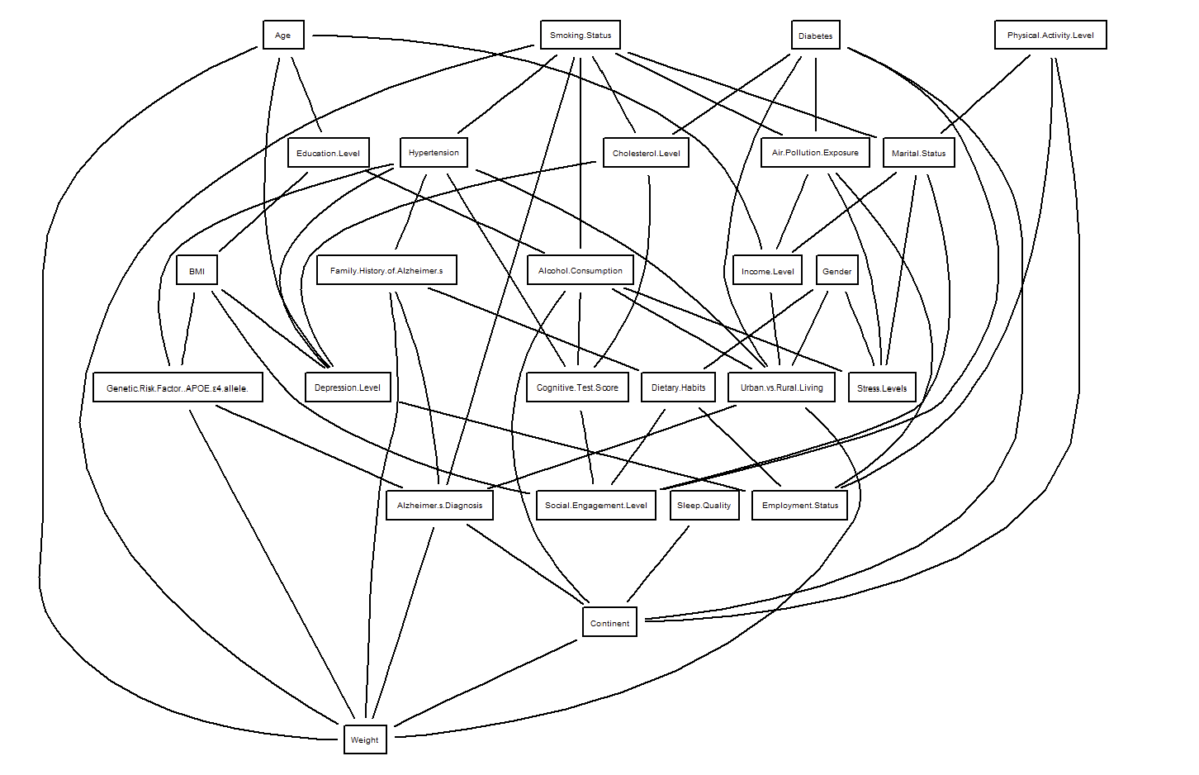
Bayesian Network: Local Discovery
The HC model utilizes a hybrid-based algorithm for predictor connections.
Results were identical to the score-based algorithm model.

Slide 12

Models: Baseline
Four models were developed for this project:
Generalized Linear Model (GLM)
Decision Tree
Neural Networks
Random Forest
Each model includes:
Baseline model (all predictor variables)
Stepwise selection model (forward-backward selection)
Bayesian Network-based model
GLM Approach:
Uses logistic regression to estimate probability.

Slide 13
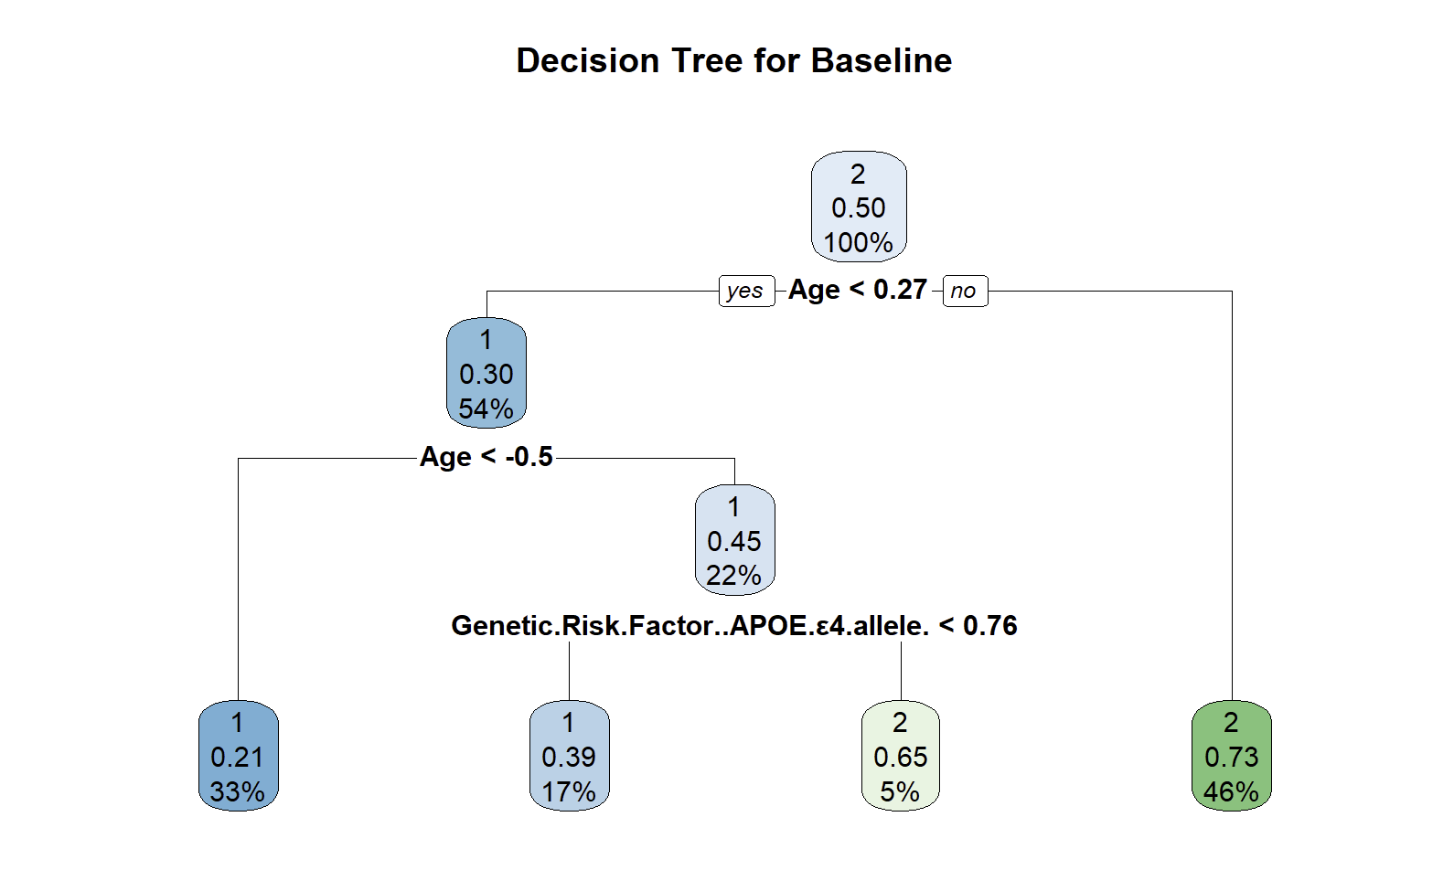
Models: Decision Tree
Decision Trees split data into subsets based on training data.
Creates a classification system to predict the target variable.
Pruning is applied using cross-validated error to prevent overfitting.
The following figures show the Decision Tree Models

Slide 14
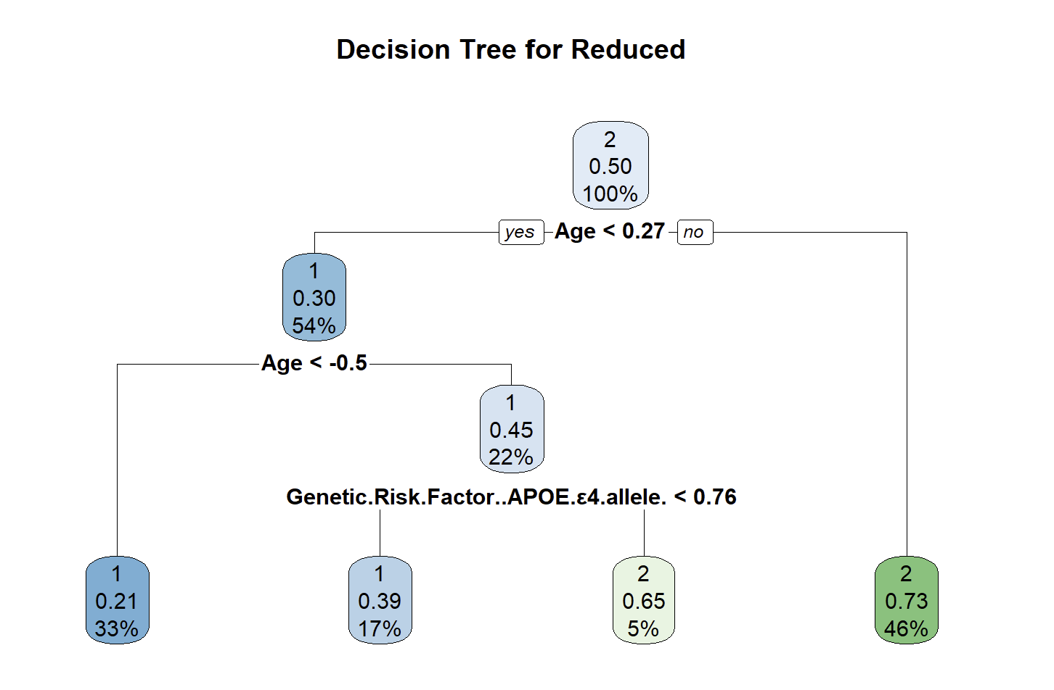
Models: Decision Tree

Slide 15
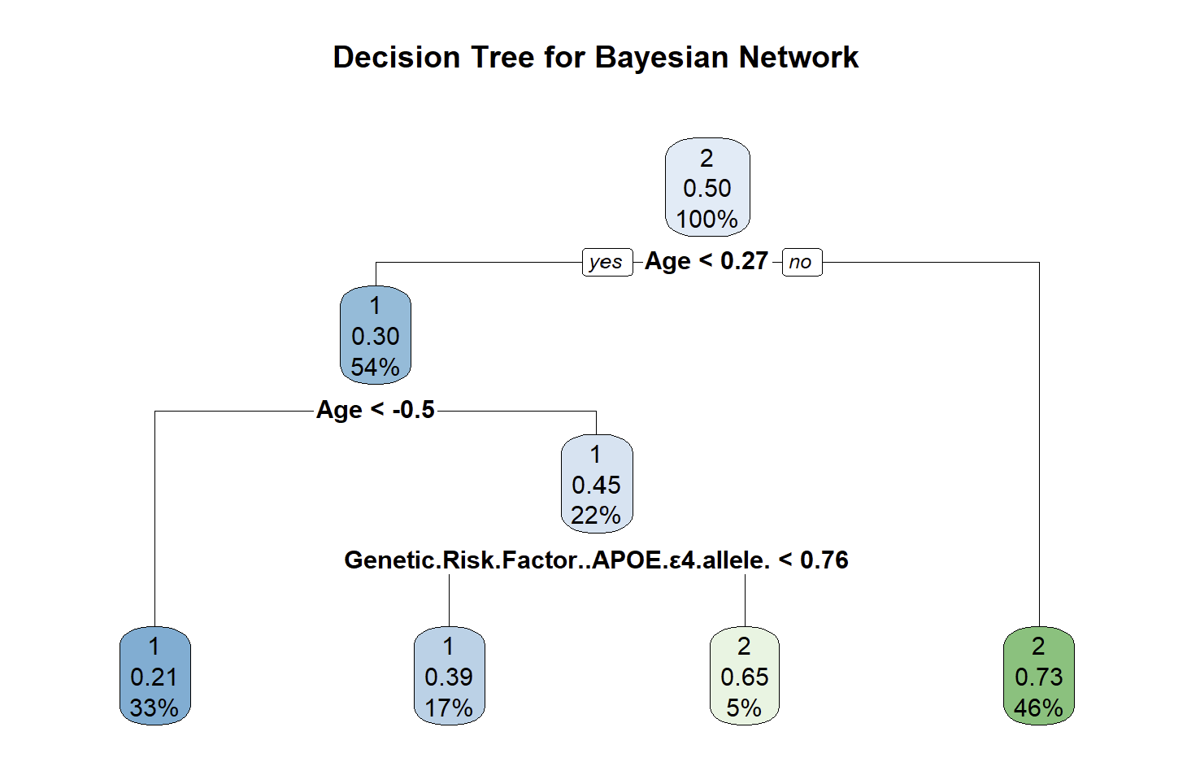
Models: Decision Tree

Slide 16
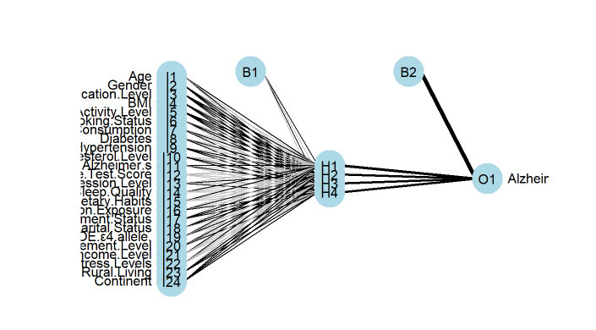
Models: Neural Networks - Baseline
Neural Network Structure:
Composed of multiple layers of interconnected “neurons”.
Each connection has a weight, adjusted during training.
Functionality:
Identifies patterns and makes predictions.
Accuracy improves over time through iterative training and weight adjustments.
Figures show the Neural Network models for each variable selection method.

Slide 17
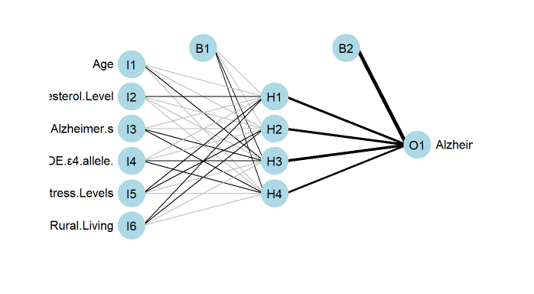
Models: Neural Networks - Reduced

Slide 18
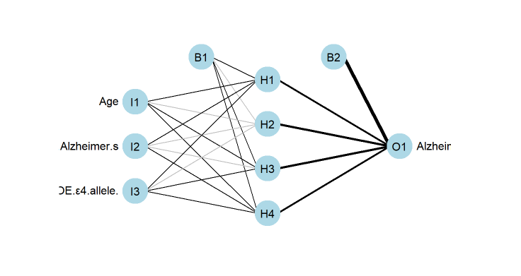
Models: Neural Networks – Bayesian Network

Slide 19

Models: Random Forest
Extension of Decision Trees using multiple trees.
Random subsets of data are used to build each tree.
Averaging results improves accuracy and reduces overfitting.

Slide 20
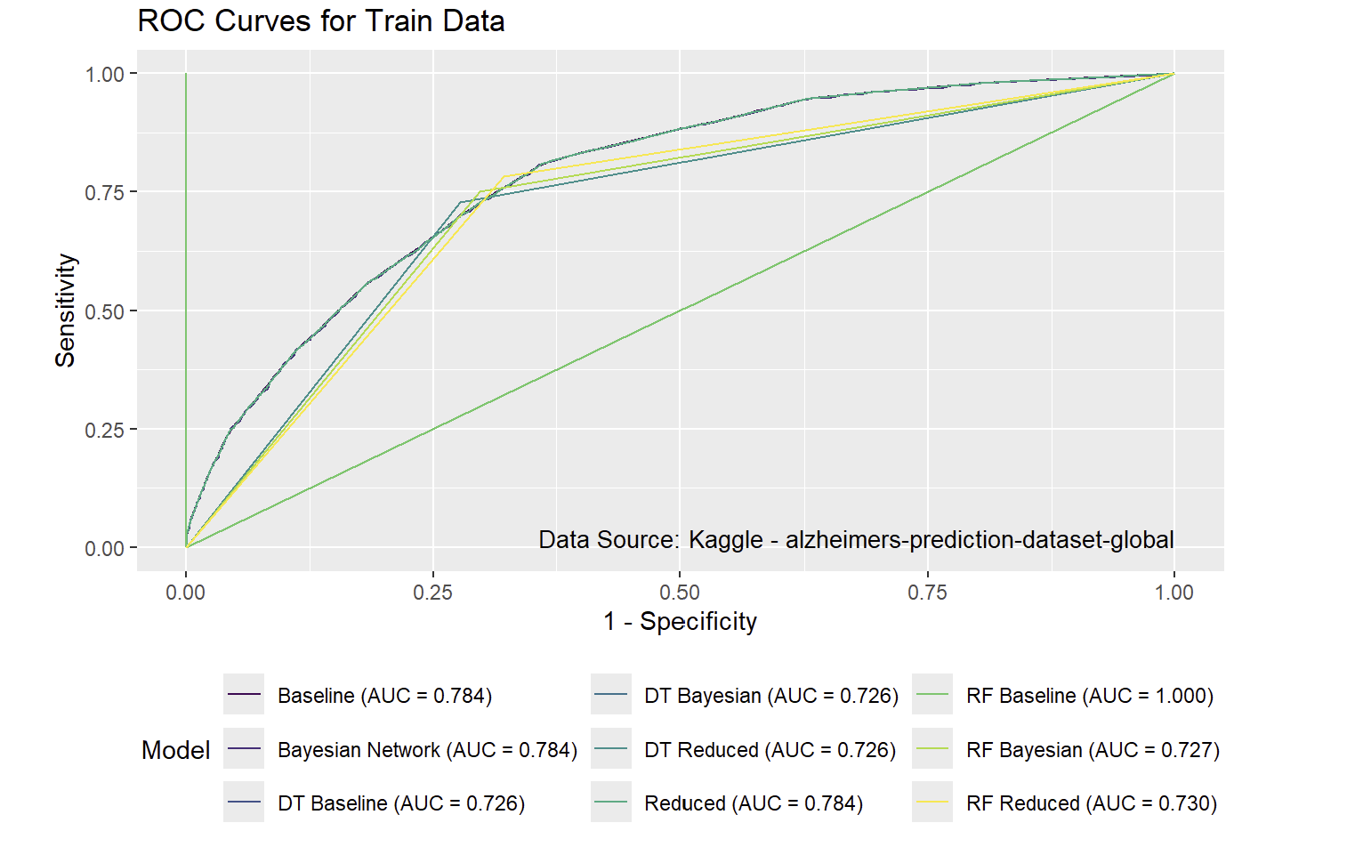
Results: Training Data

Slide 21
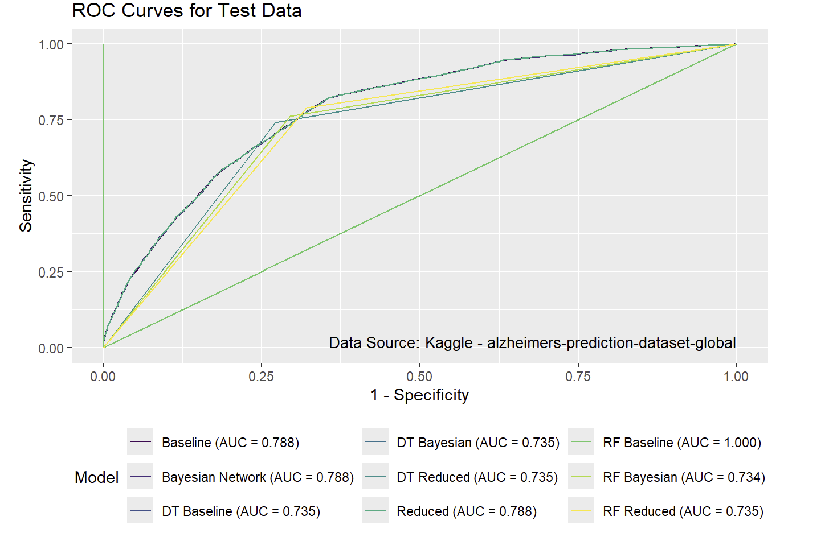
Results: Test Data

Slide 22
Summary
Goal: Identify the simplest model with strong performance.
Top Performers:
Baseline GLM and Bayesian Network GLM performed well on both training and test curves.
Random Forest Model: Achieved perfect AUC, but had a high false positive rate, making it unsuitable.
Bayesian Network Model: Used the fewest variables (age, family history, APOE genotype) while maintaining same AUC, making it the most efficient choice for implementation.

Slide 23
Works Cited
[1] Panday, A. (2025, January 30). Alzheimer’s Prediction dataset (global). Kaggle. https://www.kaggle.com/datasets/ankushpanday1/alzheimers-prediction-dataset-global
[2] Bnlearn - Bayesian Network Structure Learning. (n.d.). https://www.bnlearn.com/
[3] Smith, A. (2024). Logistic Regression Notes. Orlando; University of Central Florida.

Slide 24
Thank you
Kyle Brinker
ky601465@ucf.edu

